Slide 2
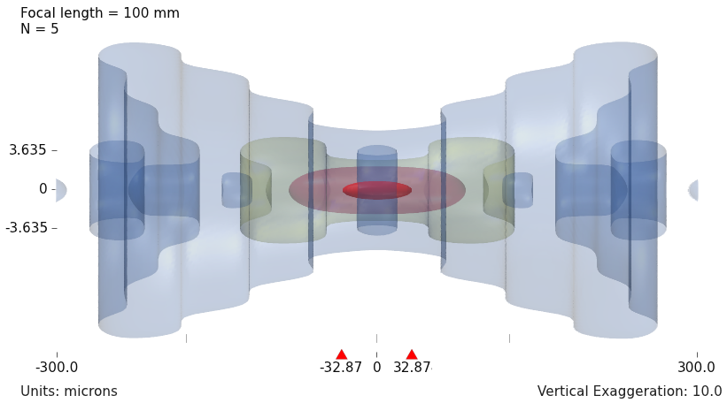
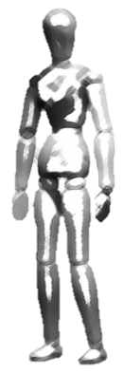
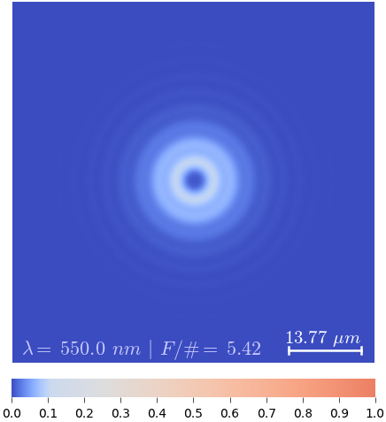
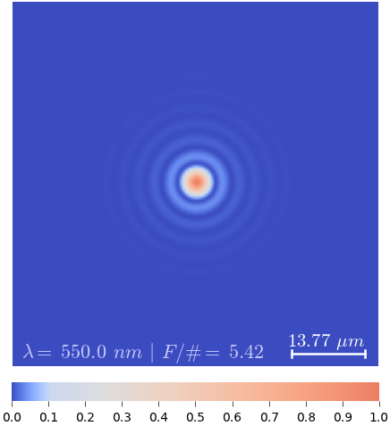
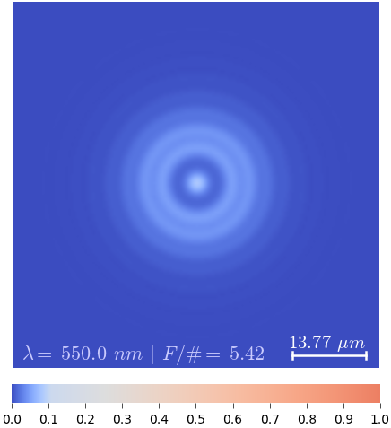
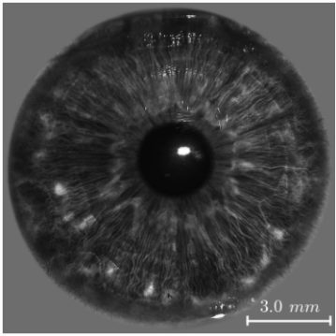
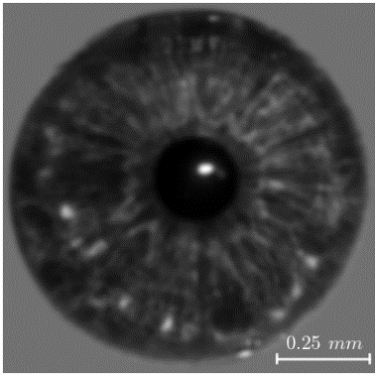

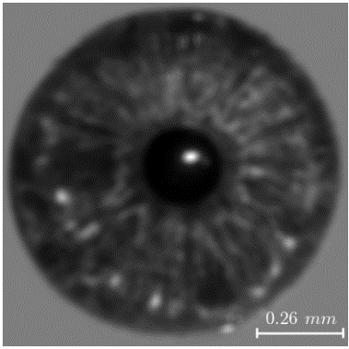
The DOF is a result of how the incoherent 3D PSF spreads out in space
5%
1%
1300 mm
108.33 mm
80%
18 mm
25 mm
20%
B
A
C
100 mm, F/5
C’
A’
B’
▴ Imaging system
▴ 3D Incoherent PSF
DOF
B’
A’
C’
▴ Object space
▾ 2D PSF
▾ Iris in object space
B/A/C
B’
A’
C’
▾ Image (simulation)
Notes:
Briefly explain what is the main cause of this limitation (DOF)
The impulse for the 3 configurations
Explain the 3-D incoherent PSF – distribution of intensity at the focal region for a particular system. Stress the fact that the “shape” (or nature) of the 3-D PSF is intimately tied to the optical systems’ performance both in terms of resolution and DOF.
The focal intensity distribution, as we shall see later, is strongly influenced by the characteristics of the aperture, which we shall call the pupil function.
Assuming a linear system model, tell how the impulse response is obtained (slices of the 3-D intensity distribution, which is the 3D incoherent PSF)
Explain, again, the idea of DOF – what does the “red” zone in the 3-D PSF correspond to? There is a corresponding zone in the object side where you can still get acceptable quality images.

Slide 3
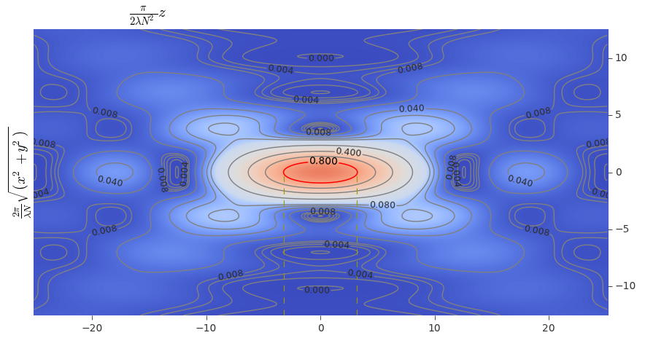
Visualizations of intensity distribution of light near the focal region

Slide 4
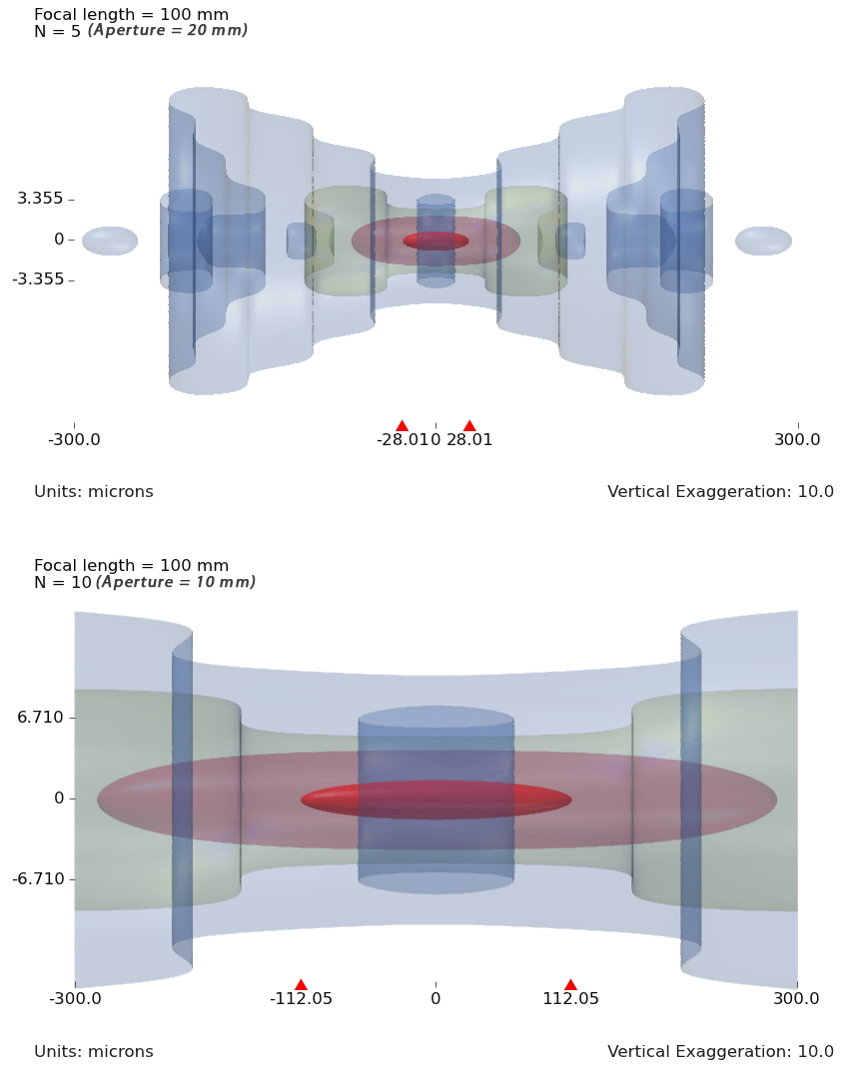
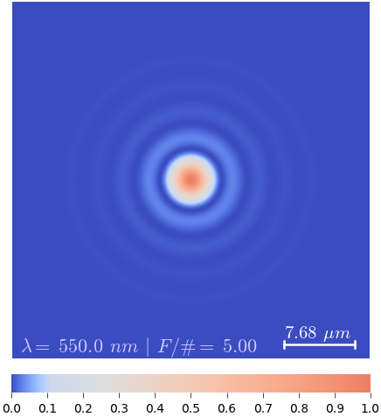
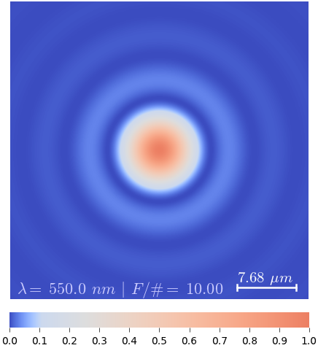
Controlling the DOF by aperture size is a classical (probably bygone) method
18 mm
25 mm
B
A
C
Focal length = 100 mm
F/# = 5 (aperture = 20 mm)
5%
1%
80%
20%
▴▾ Object space ▴▾ Aperture ▴▾ 3D Incoherent PSF ▴▾ 2D PSF at focus
(DOF indicated by hor. bar)
Focal length = 100 mm
F/# = 10 (aperture = 10 mm)
5%
1%
80%
20%
Notes:
It can be seen that by halving the aperture diameter (doubling the F-number, $F\#$) the DOF increased four folds, which are indicated by the red triangle markers on the horizontal axis; however, the diffraction spot-size also increased two folds consequently halving the spatial resolution.

Slide 5
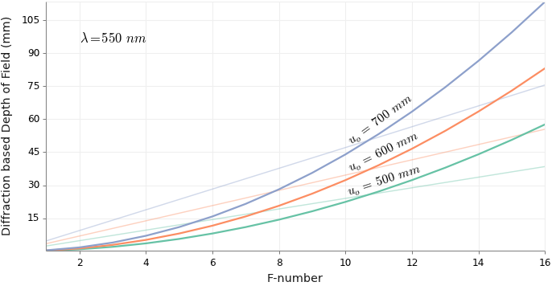
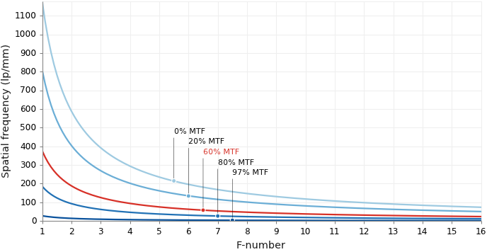
Extending the DOF by decreasing the aperture size is not a viable solution
◂ Variation of DOF with F/# (the curved lines are diffraction based DOF, the straight lines are geometric DOF)
◂ Spatial frequency response vs. F/#
Notes:
Loss of light implying low SNR
Loss of optical spatial resolution.

Slide 6
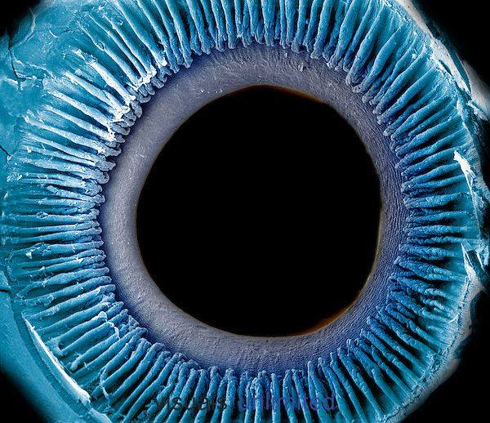
Inner surface of the iris, pupil, and ciliary processes
The lens was removed to show the posterior surface of these structures.
Credit: Dr. Richard Kessel & Dr. Randy Kardon/Tissues & Organs/Visuals Unlimited, Inc.

Slide 7
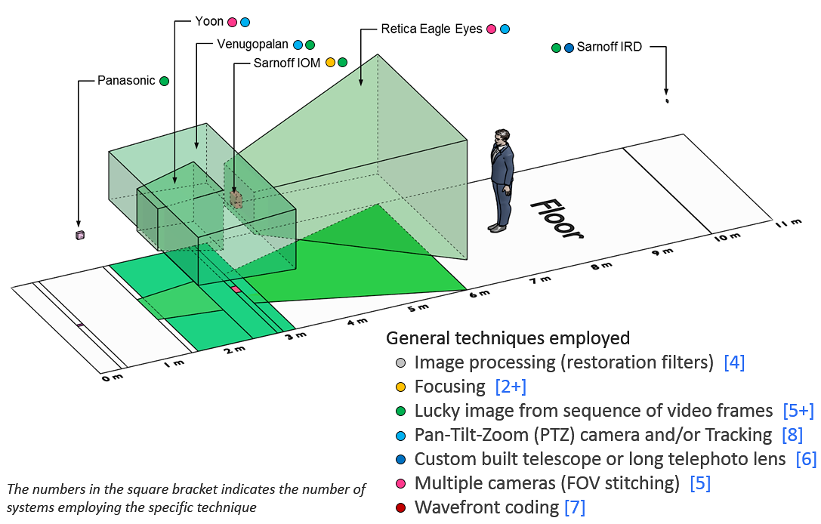
State-of-the-art iris acquisition systems

Slide 8
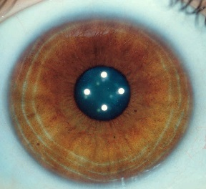
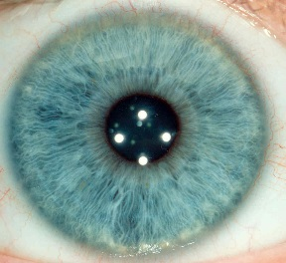
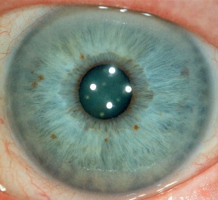
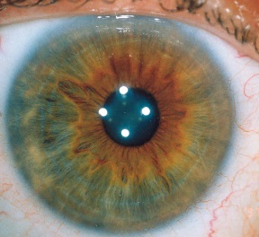
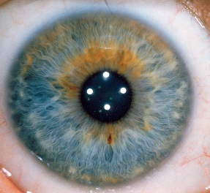
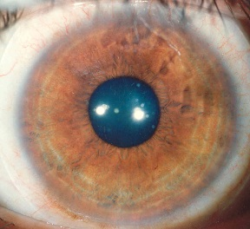
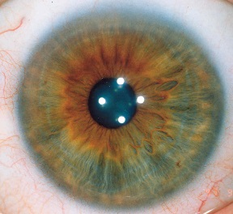
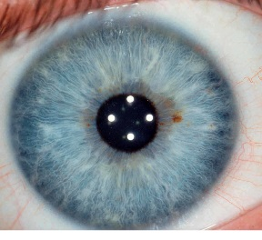
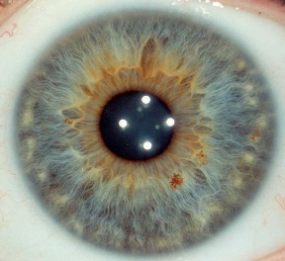
Unique
0.000000000000000000000000000000000000000000000000000000000000000000000001
[Photographs by Jon Miles, milesresearch.com]
Notes:
That’s 71 zeros between the decimal point and the one. That’s the probability that two irises, the colored tissue surrounding the pupils in the eyes, picked at random, will exactly match. That is how staggeringly unique each iris pattern is … but that’s not all.

Slide 9
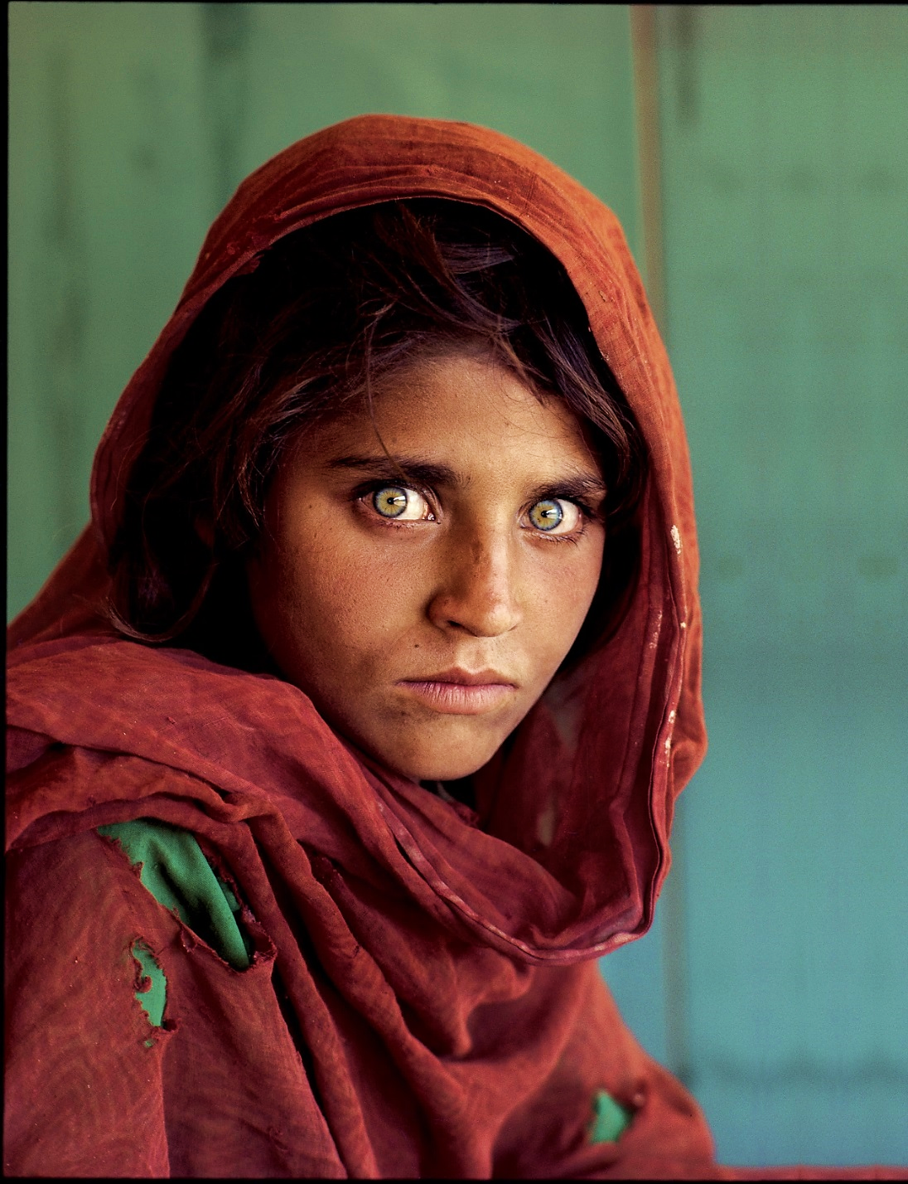
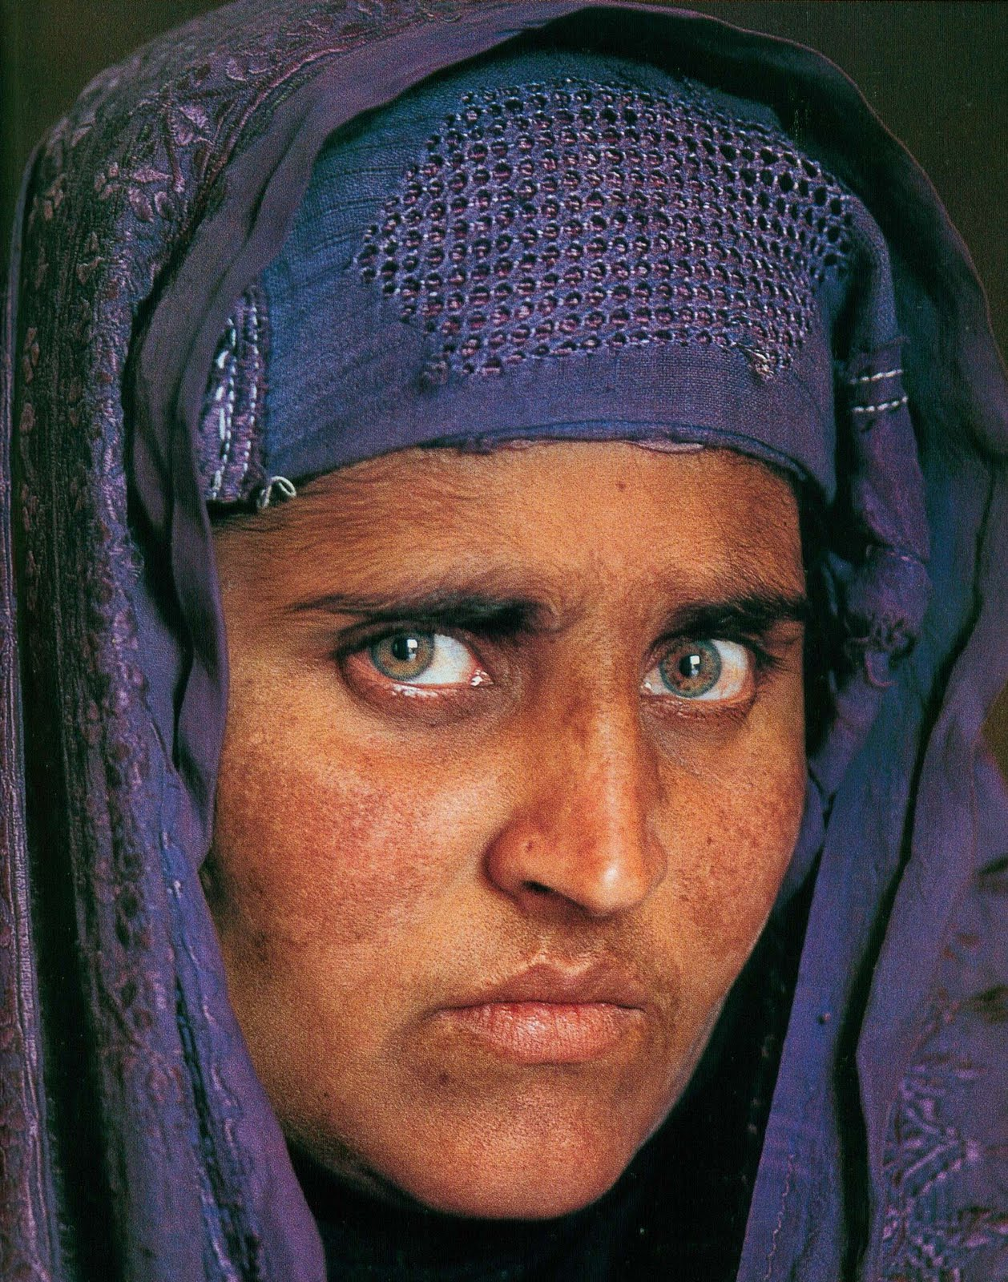
Stable
12 years old, refugee camp, Pakistan, 1984.
Found after 17 years, in 2002.
[Photographs by Steve McCurry, National Geographic.]
Notes:
National Geographic was able to identify and find the real name of the Afghan girl, whose iconic picture became a symbol for the plight of refugees throughout the world, after 17 years by matching the iris patterns. That story demonstrates the stability of the iris pattern.
(Her name: Sharbat Gula)

Slide 10
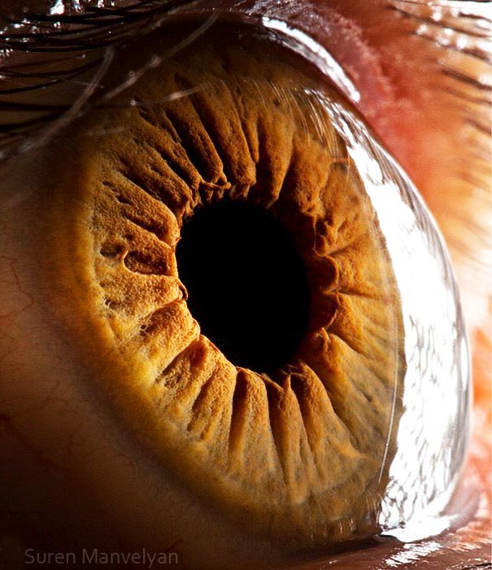
Protected from tampering
[Photograph by Suren Manvelyan, surenmanvelyan.com]
Notes:
Since the transparent cornea covers the iris … it is relatively safe from both accidental and intentional tampering.

Slide 11
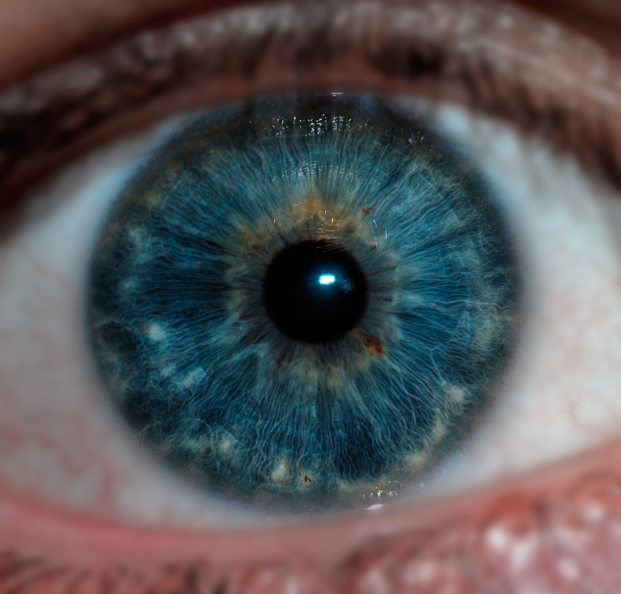
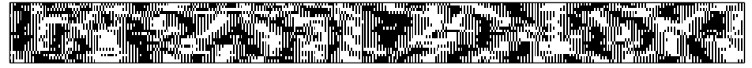
The iris pattern is ideal for biometric authentication and recognition
[Photograph by Dr. Jan Drewes, jandrewes.de]

Slide 12
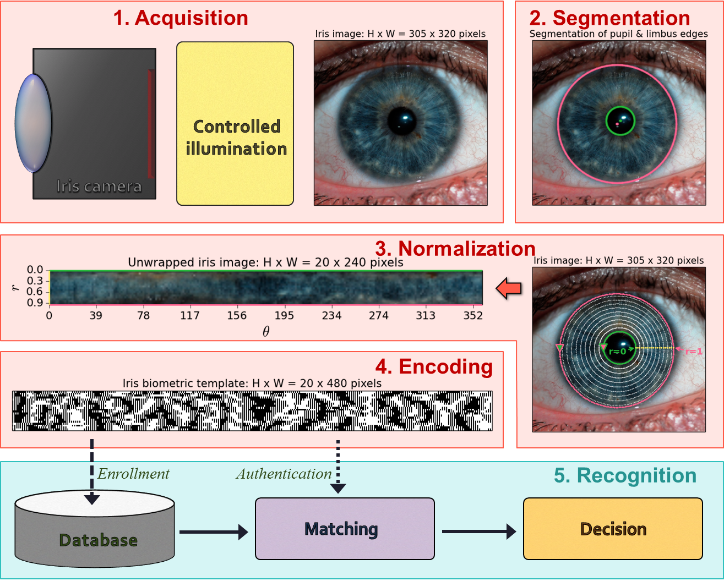
Iris recognition pipeline

Slide 13
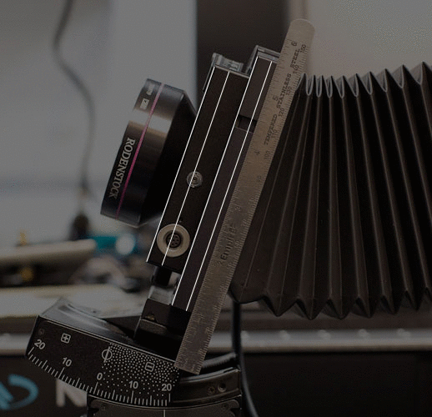

Slide 14
